Slide 1


Development of a Dataset and Deep Learning Models for Named Entity Recognition and Joint Word Segmentation in Sanskrit
Presented By:
Razorshi Prozzwal Talukder
Department of Computer Science and Engineering
Indian Institute of Engineering Kharagpur
Guided By:
Prof. Pawan Goyal
Sujoy Sarkar(Phd)

Slide 2
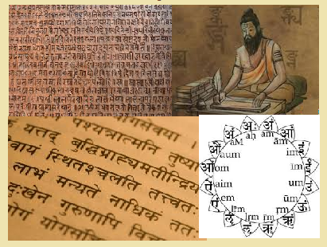
Contents
Introduction
Objectives
Dataset
Literature Survey
Methodology and Experimental Results
Conclusion and Future Work
Motivation and Challenges

Slide 3
Contents
Introduction
Objectives
Dataset
Literature Survey
Methodology and Experimental Results
Conclusion and Future Work
Motivation and Challenges

Slide 4
Introduction
What is NER?
A process of identifying and classifying named entities in text into predefined categories such as Person, Organization, Location name etc.
Example
Current Situation in Sanskrit
Lack of Annotated Dataset in Information Retrieval tasks.
yudhiṣṭhiro'pi kaitavyamulūkamidamabravīt
ulūka madvaco brūhi gatvā tāta suyodhanam
“Sauptika Parva" in the Mahabharata, Ninth book of the epic (Chapter 6, Verse 31)”

Slide 5
Contents
Introduction
Objectives
Dataset
Literature Survey
Methodology and Experimental Results
Conclusion and Future Work
Motivation and Challenges

Slide 6

Motivation
Challenges
Motivation
Less Work
Preservation of cultural heritage
Linguistic challenge
Research Opportunities
yudhiṣṭhiro'pi kaitavyamulūkamidamabravīt
ulūka madvaco brūhi gatvā tāta suyodhanam
yudhiṣṭhiraḥ-api
kaitavyam-ulūkam-idam-abravīt
suyodhanam
Inflection
( suyodhana – suyodhanam )
Common noun used as name.
Ulūka is also owl
Sandhi: Identification of Entity boundary.
Multiple entities within same token.
Ulūka is Kaitavya, son of Śakuni.
Instead of names relation are used to address frequently.
- 'pāṇḍuputra'

Slide 7
Contents
Introduction
Objectives
Dataset
Literature Survey
Methodology and Experimental Results
Conclusion and Future Work
Motivation and Challenges

Slide 8

Literature Review
Sanskrit Word Segmentation Using Character-level Recurrent and Convolutional Neural Networks
It introduces end-to-end neural network models that tokenize Sanskrit by jointly splitting compounds and resolving phonetic merges (Sandhi).
Tokenization of Sanskrit depends on local phonetic and distant semantic features that are incorporated using convolutional and recurrent elements.
Neural Chinese Named Entity Recognition via CNN-LSTM-CRF and Joint Training with Word Segmentation
End-to-end Sequence Labeling via Bi-directional LSTM-CNNs-CRF
A novel neural network architecture that benefits from both word- and character-level representations automatically, by using combination of bidirectional LSTM, CNN and CRF.
Bidirectional LSTM-CRF Models for Sequence Tagging
Proposed a neural approach for CNER.
That framework to jointly train CNER and Word Segmentation model in identifying entity boundaries.
Neural Architectures for Named Entity Recognition
Two new neural architectures—one based on BiLSTMs and CRF, and the other that constructs and labels segments using a transition-based approach inspired by shift-reduce parsers.
This models rely on two sources of information about words: character-based word representations learned from the supervised corpus and unsupervised word representations learned from unannotated corpora.
It's about Long Short-Term Memory (LSTM) based models for sequence tagging.
These models include LSTM networks, bidirectional LSTM (BI-LSTM) networks, LSTM with a CRF layer (LSTM-CRF) and bidirectional LSTM with a CRF layer (BI-LSTM-CRF).

Slide 9
Contents
Introduction
Objectives
Dataset
Literature Survey
Methodology and Experimental Results
Conclusion and Future Work
Motivation and Challenges

Slide 10

Objectives
Manual classification of Entity names from Mahabharata.
Testing NER model by preparing data with Automatic Segmentation and identifying the challenges there.
Preparing the NER data with Gold Segmentation.
Developing Joint model and identifying the challenges.

Slide 11
Contents
Introduction
Objectives
Dataset
Literature Survey
Methodology and Experimental Results
Conclusion and Future Work
Motivation and Challenges

Slide 12
Existing Dataset (Being Developed)
Itihasa (Mahabharata) Dataset Details
74K verses with 10k Entities, and 1.09L Mentions
yudhiṣṭhiro'pi kaitavyamulūkamidamabravīt
ulūka madvaco brūhi gatvā tāta suyodhanam
kaitavyamulūkamidamabravīt
Entity
‘Kaitavya’
‘ulūka’
Token
yudhiṣṭhiro'pi
Entity
‘yudhiṣṭhira’
Problem
suyodhanam
Entity
‘suyodhana’
No classification of Entities.
Boundaries of NEs are no given
ulūka
Entity
‘ulūka’

Slide 13

Dataset
Manual Classification of Mahabharata Names
Person | Location | Miscellaneous
9534 | 599 | 532
Classification of 10K Entities into three class labels
Descriptions are scrapped from
yuvanASva : Yuvanāśva, an ancient king
Index to the Names in Mahabharata Dictionary
Monier William Dictionary
Sanskrit Word Segmentation Using Character-level Recurrent and Convolutional Neural Networks
Tokens: 9.8 L
Problems Identified
Names got segmented
sūrya-datta-ādibhiḥ-vīraiḥ-madirā-akṣa-purogamaiḥ ['sūryadatta', 'madirākṣa']
Segmentation not correct
mahā-iṣvāsaidraupadī ['draupadī']
Token did not segment
maitreyodhārtarāṣṭram ['dhārtarāṣṭra', 'maitreya']
Existing Dataset
kaitavyamulūkamidamabravīt ['kaitavya', ‘ulūka’]
kaitavyam-ulūkam-idam-abravīt
Tokens: 13 L

Slide 14
Dataset Continue…
Token contains multiple names and is not segmented | 56
Token contains a single entity name and is segmented | 7008
Token contains entity name Sandhied with other words and the name is not segmented | 3348
Token contains entity name Sandhied with other words and the name is segmented | 6565
Statistics after Applying Segmentation Model to Dataset
Find Mapping between Two Corpora (Itihasa and DCS)
 | Total Lines | Set (Line) | Common Lines (DCS vs Itihasa) | Total Words in File | Set (Words) | Common Words (DCS vs Itihasa) | Difference (Itihasa -DCS)
DCS | 962 | 932 | 443 | 6277 | 2525 | 2011 | 276
Itihasa | 789 | 781 |  | 5171 | 2287
Matching between Itihasa and DCS Corpus (Volume: 1, Chapter:2)

Slide 15
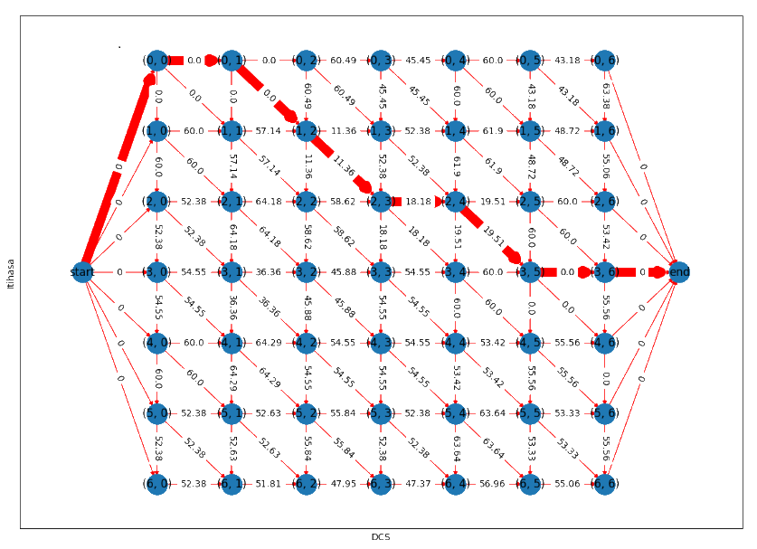
Matching (Itihasa vs DCS) - Volume 1 Chapter 2
Itihasa Metrical Line Number | DCS Metrical Line Number
0 | 0, 1
1 | 2
2 | 3, 4
3 | 5, 6
Data Matching (Itihasa vs DCS)
Anushasana Parva (Volume 13), Chapter 8, Verse 67
Itihasa: annAdya BUtAH lokasya iti api SrUyate SrutiH
DCS: anAdi BUtA BUtAnAm iti api SrUyate SrutiH
Similarity: 75.95
Distance: 100 - 75.95 = 24.05

Slide 16
Contents
Introduction
Objectives
Dataset
Literature Survey
Methodology and Experimental Results
Conclusion and Future Work
Motivation and Challenges

Slide 17
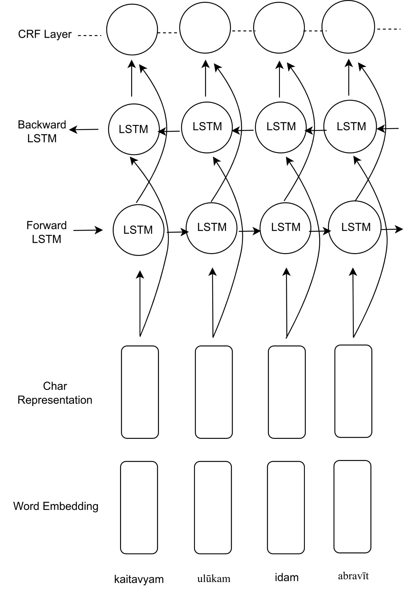
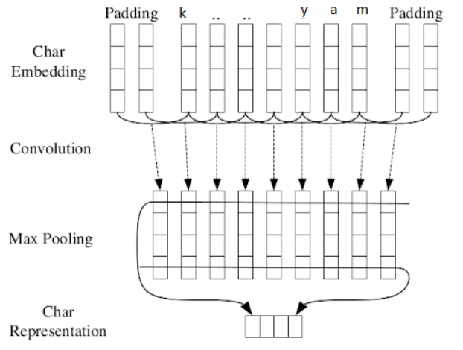
Testing Standard NER Model
Main architecture of neural network. The character representation for each word is computed by the CNN & LSTM
The convolution neural network for extracting character-level representations of words. Dashed arrows indicate a dropout layer applied before character embeddings are input to CNN

Slide 18
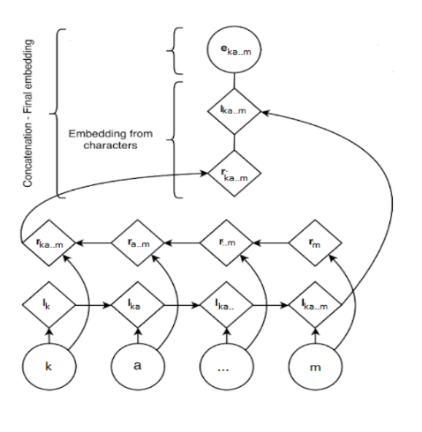
Testing Existing NER Model….
The character embeddings of the word “kaitavyam” are given to a bidirectional LSTMs. We concatenate their last outputs to an embedding from a lookup table to obtain a representation for this word.

Slide 19
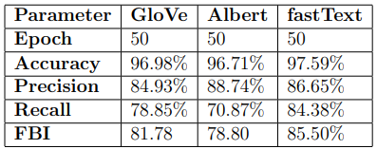
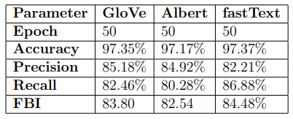
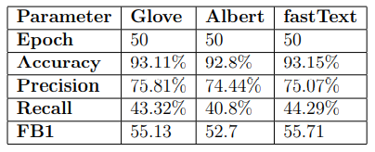
Result of NER Model
Dataset 1(Itihasa)
Random Split
Train Size: 80%
Valid Size: 10%
Test Size: 10%
Less Over Split
Train Size: 80%
Valid Size: 10%
Test Size: 10%
When Character Embedding Mode is: CNN
When Character Embedding Mode is: LSTM
When Character Embedding Mode is: CNN

Slide 20
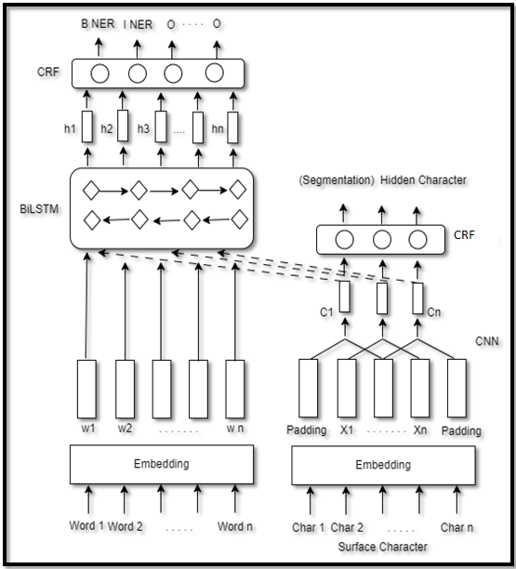
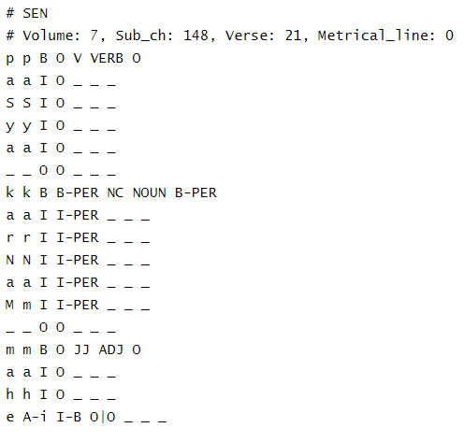
Proposed Model
The framework of our Approach Model
Dataset Format

Slide 21
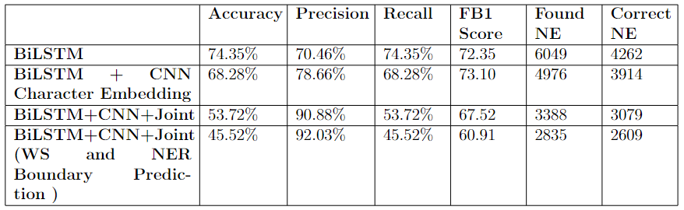
Experiments Result
In every experiment, we applied 20 epochs.
Predicts whether a Token contained Name Entity or Not.
Number of Tokens containing NE: 5732. (Test Dataset)
Dataset 2
Input Dataset Format in Model
Ratio of Train : Validation : Test
80 : 10 : 10
Result of Experiment Models
BiLSTM: Uses only token level embedding.
BiLSTM + CNN Character Embedding: Uses token level embedding and Character embedding of token.
BiLSTM + CNN + Joint: Segmentation hidden character for each surface character.
BiLSTM + CNN + Joint (WS and NER Boundary Prediction at Character Level): Within the token NE boundary at character level Segmentation hidden character for each surface character

Slide 22
Result Discussion
Precision has increased with joint model, but overall performance did not improve as recall is becoming less.
Model only predicting NE , NE classification (PER, LOC, MISC not tested). Requires changes in model.
Further analysis required in identified ne boundary at character level.

Slide 23
Contents
Introduction
Objectives
Dataset
Literature Survey
Methodology and Experimental Results
Conclusion and Future Work
Motivation and Challenges

Slide 24
Future Work
Improving the model in character level identification
Improving analysing the result of joint model
Using the available weights of pretrained segmentation model

Slide 25
Conclusion
Neural approach for Sanskrit NER
Testing neural network architecture for sequence labeling to recognize named entities in Sanskrit, without relying on any task-specific resources, feature engineering, or data pre-processing
Framework for improving NER model
Proposed framework for training Sanskrit NER and word segmentation models together to improve the model's ability to identify entity boundaries.
Need for high-quality labeled dataset
Developing an effective NER model for Sanskrit requires a large, high-quality labeled dataset of Sanskrit text with annotated named entities. Training on a small or low-quality dataset may result in poor performance. Further research and resources are needed for effective models.

Slide 26
References
Lample, G., Ballesteros, M., Subramanian, S., Kawakami, K. and Dyer, C., 2016. Neural architectures for named entity recognition. arXiv preprint arXiv:1603.01360.
F. Wu, J. Liu, C. Wu, Y. Huang, and X. Xie, “Neural chinese named entity recognition via cnn-lstm-crf and joint training with word segmentation,” in The World Wide Web Conference, pp. 3342–3348, 2019.
Hellwig, O. and Nehrdich, S., 2018. Sanskrit word segmentation using character-level recurrent and convolutional neural networks. In Proceedings of the 2018 conference on empirical methods in natural language processing (pp. 2754-2763).
Ma, X. and Hovy, E., 2016. End-to-end sequence labeling via bi-directional lstm-cnns-crf. arXiv preprint arXiv:1603.01354.
Huang, Z., Xu, W. and Yu, K., 2015. Bidirectional LSTM-CRF models for sequence tagging. arXiv preprint arXiv:1508.01991.

Slide 27
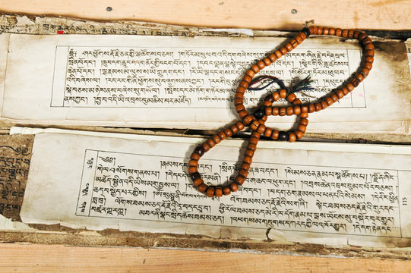
Thank You

